Slide 1


Slide 2
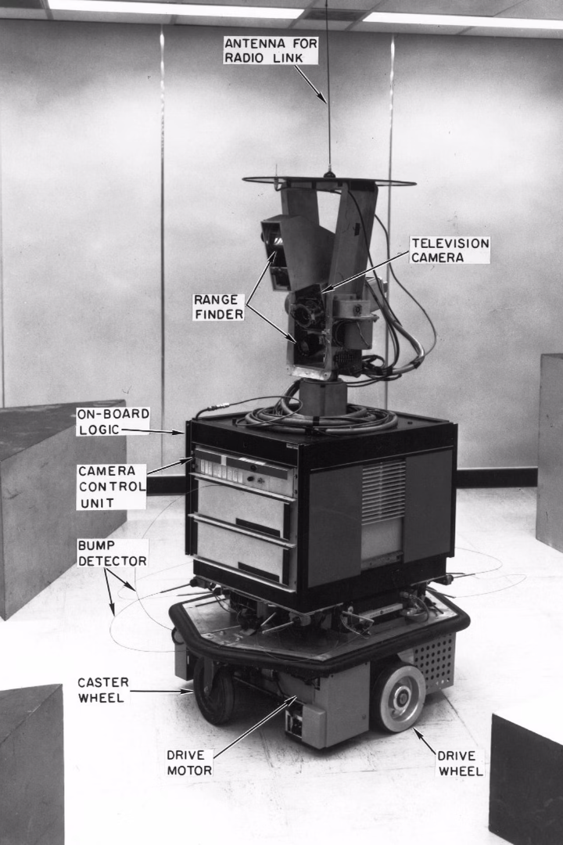
Historical Background
Introduction
Purpose
Developed in 1968 by Hart, Nilsson, and Raphael at SRI International for the Shakey project.
Improved Dijkstra's algorithm by adding heuristic information.
Applications
Popular in AI, robotics, and operations research for efficient pathfinding.

Slide 3

Mathematical Foundations
Cost Function
g(n)
f(n) = g(n) + h(n), combining actual and heuristic costs.
Actual cost from start to node n.
h(n)
Heuristic estimate from node n to goal; must be admissible.

Slide 4

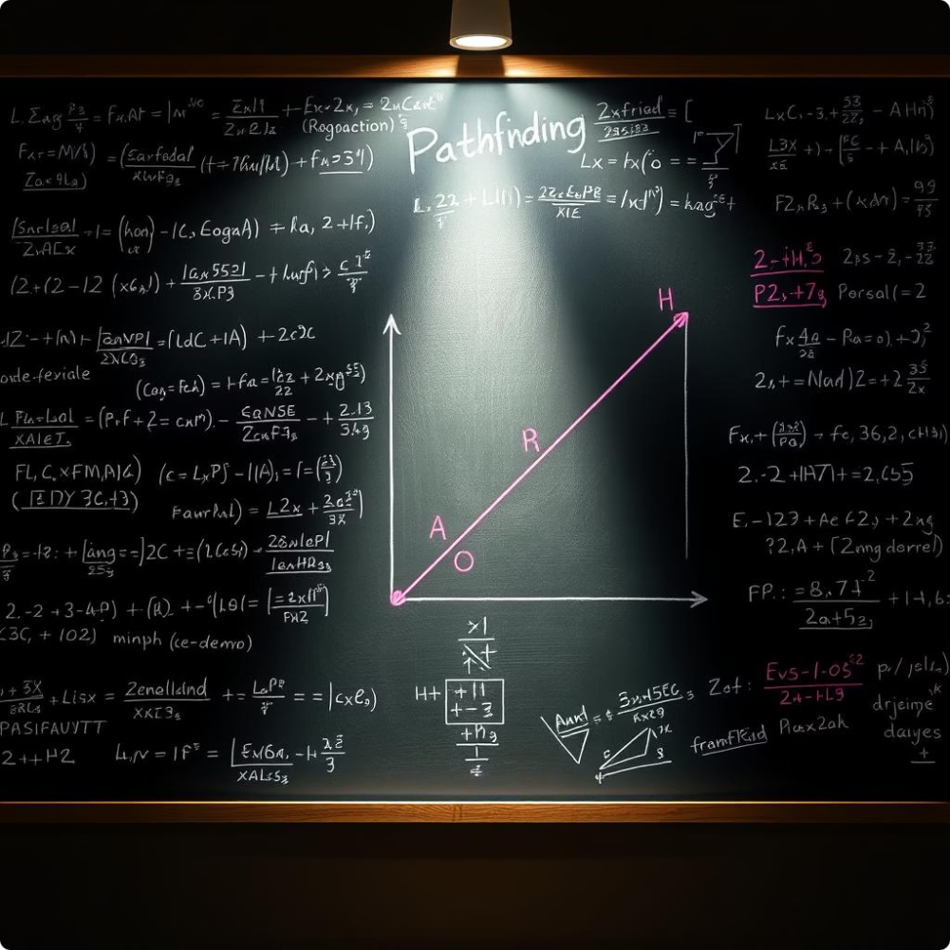



Proof of Correctness
Optimality
A* returns optimal path if heuristic is admissible.
Consistency
Consistent heuristics ensure non-decreasing f-values and no revisits.
Complexity
Time: O(b^d) in worst case
Space: O(b^d) due to node storage

Slide 5
Comparisons with Similar Algorithms
Dijkstra's Algorithm
Greedy Best-First
BFS & DFS
Equivalent to A* with zero heuristic; optimal but slower.
Uses heuristic only; faster but not optimal.
BFS optimal for unit costs; DFS not optimal and may not terminate.

Slide 6

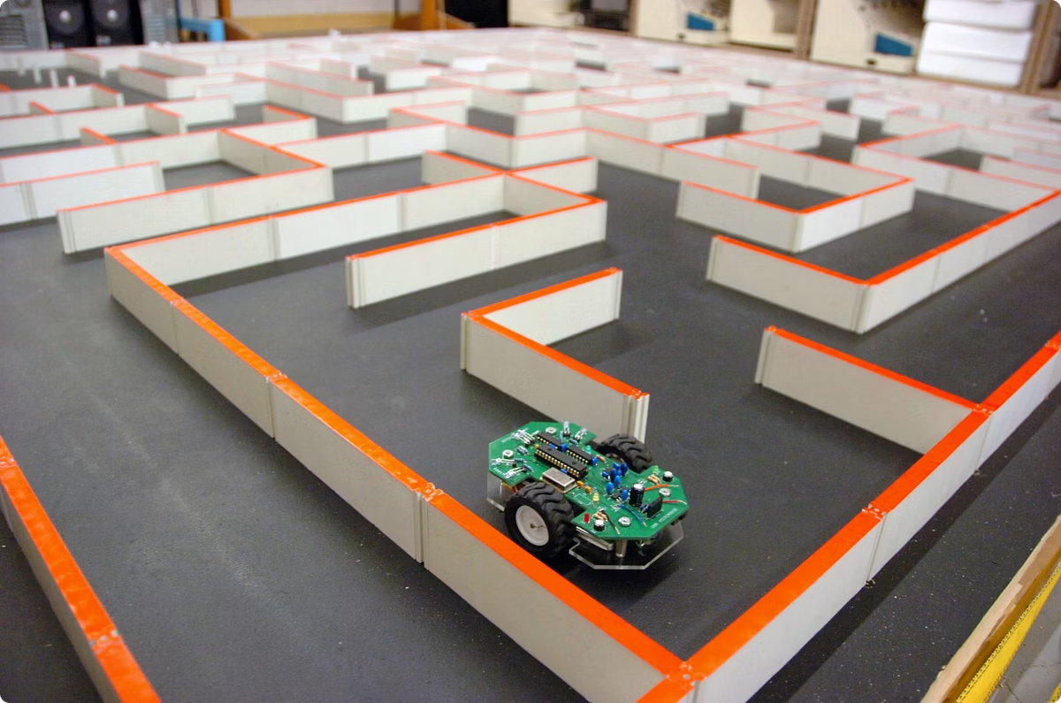
Project-Specific Modifications
Our A* algorithm implementation takes pathfinding to the next level by incorporating the advanced Haversine heuristic. Unlike the standard Manhattan distance, this specialized function accounts for the curvature of the Earth, delivering unparalleled precision when navigating across vast terrains. By considering the planet's radius, our A* algorithm can chart the truly optimal route, guiding our vehicle seamlessly through global-scale challenges.

Slide 7

Performance and Optimization
Heuristic Design
Use Haversine distances for better estimates.
Early Goal Test
Stop search when goal is dequeued, not generated.

Slide 8

References
Hart, Nilsson, & Raphael (1968). IEEE Transactions on Systems Science and Cybernetics.
Russell & Norvig (2020). Artificial Intelligence: A Modern Approach.
Pearl (1984). Heuristics: Intelligent Search Strategies.

